Slide 1

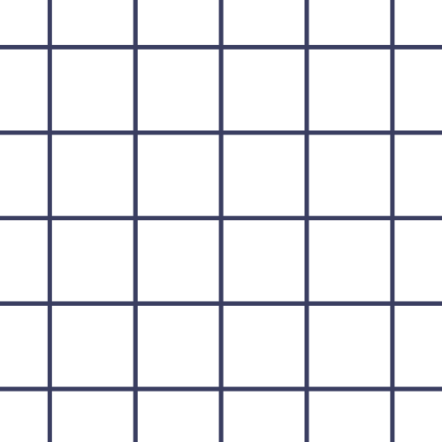


Page
01
INTRO TO
FLUTTER
github.com/Shaan-Shoukath
Presented by Shaan Shoukath

Slide 2


Page
02
So… What Even Is Flutter?
  Open-source UI framework by Google
  Used to build mobile, web, and desktop apps
  Single codebase for multiple platforms

Slide 3
Page
03
Wait… What’s Dart?
  Programming language used by Flutter
  Simple and easy to read
  Beginner-friendly
  Only basic Dart needed to build apps
  Flutter → framework
  Dart → language
  We write Dart code
  Flutter converts it into a working app

Slide 4
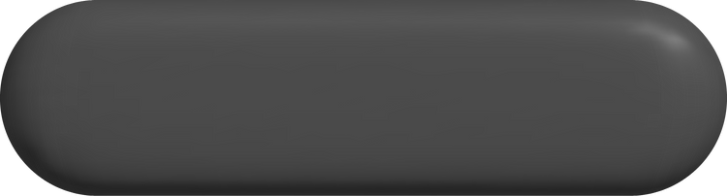
Page
04
Installation Guide
Click Here

Slide 5
Page
04
From Code to Screen..
Step 01
Step 02
  We write code in Dart
  Code is made of widgets
  Widgets describe the UI
  Flutter reads the widget tree
  It draws everything on the screen
  Same UI on every platform

Slide 6
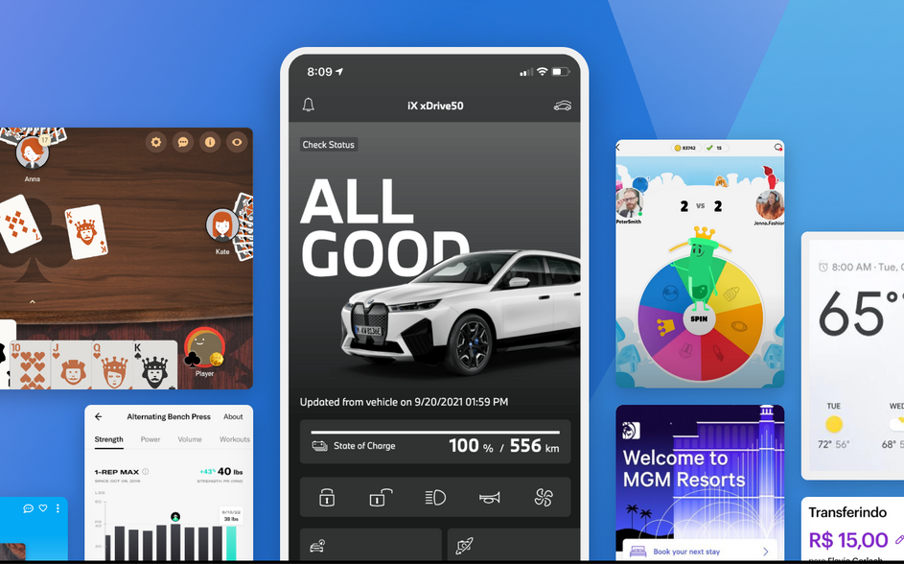
Page
05
Are We Ready to Run Flutter?
Setup Checklist
  Flutter SDK installed
  Code editor (VS Code / Android Studio)
  Emulator or physical device
  flutter doctor runs without major errors

Slide 7
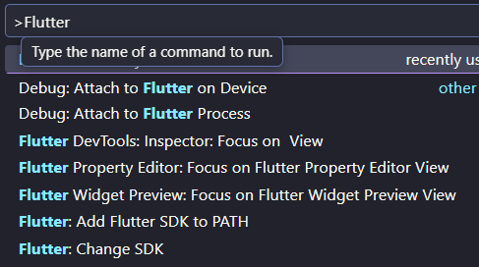
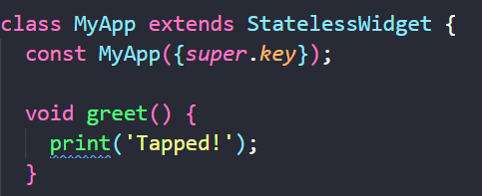
Page
06
What We’re About to Do.
  Create a new Flutter project
  Run the default app
  See Flutter working
In this section, we’ll create a brand-new Flutter project using VS Code, run the default app, and see Flutter in action. The goal isn’t to understand every line of code yet, but to get comfortable with how quickly Flutter turns code into a working app on the screen.

Slide 8
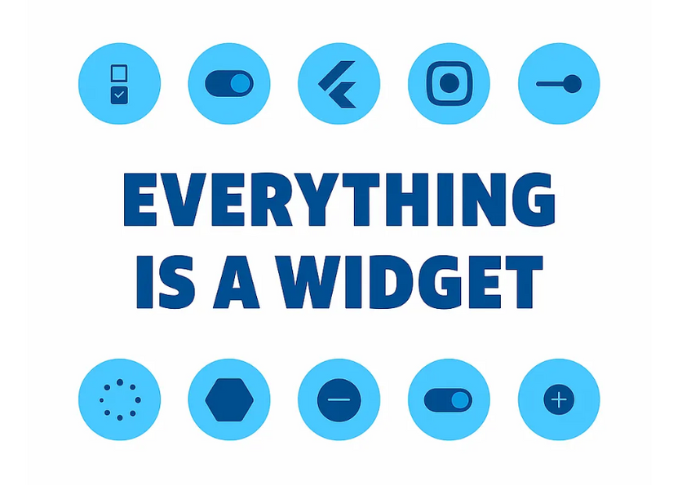
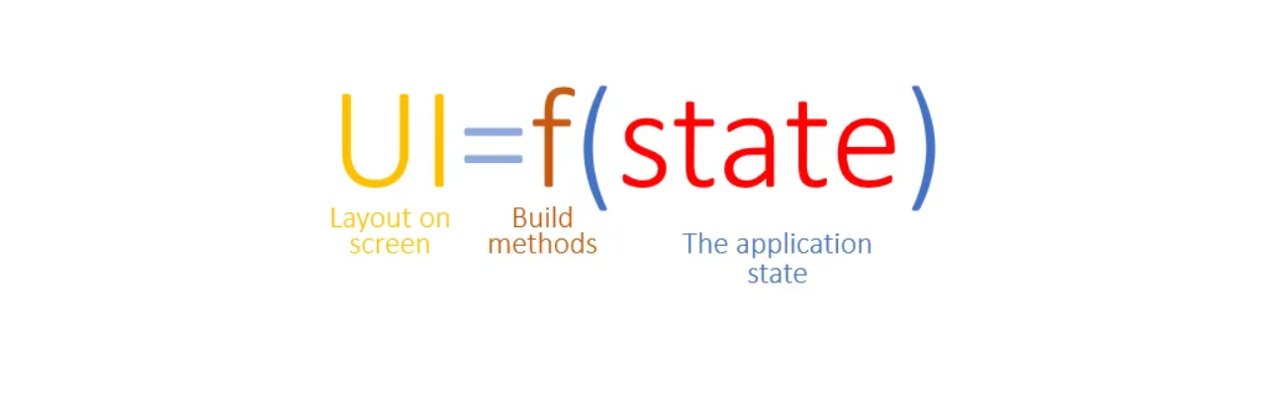
Page
07
Everything Is a Widget 🤯
What is a Widget?
  Building block of Flutter UI
  Describes what appears on the screen
  Combined to create layouts
Two Types of Widgets
  Stateless Widget → UI does not change
  Stateful Widget → UI can change
Example:
Text → Stateless
Counter → Stateful

Slide 9
Page
08
Thank You.😁

